Slide 1
CREDIT CARD EDA

Slide 2
The loan providing companies find it hard to give loans to the people due to their insufficient or non-existent credit history.
So we have to find the customers capable of repaying the loan are not rejected.

Slide 3
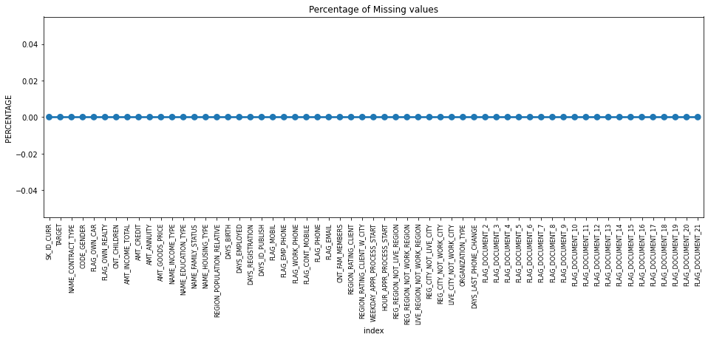
The data is two huge, has lots of values in it. Also there are lots of missing values in the data, also the data has lots of XNA values in the column like gender.
Also have to remove lots of columns.

Slide 4
Univariate Analysis for categorical data

Slide 5
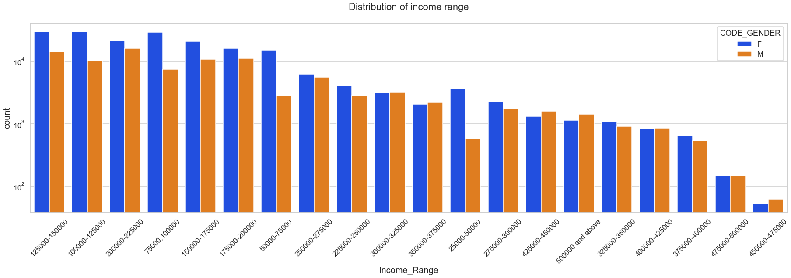
we see that the number of females are higher than the number of males
most of the customers who have paid the bills on time are mostly from higher income range and they have the higher credit limit

Slide 6
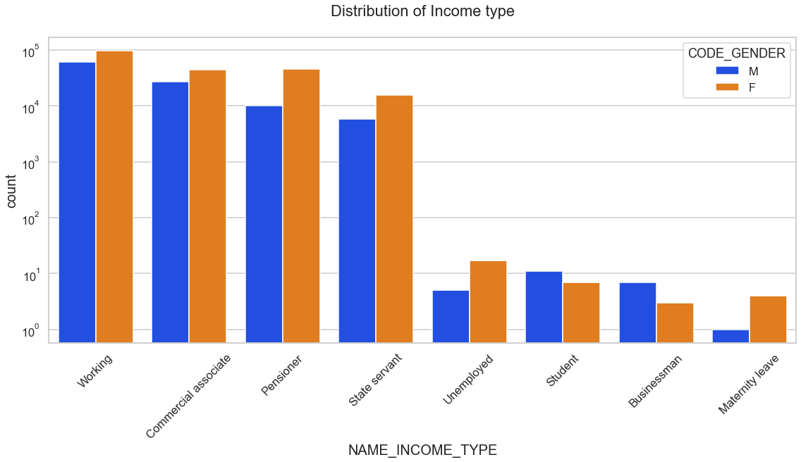
working, commercial associate, Pensioners and State Servants having the most number of credit in that count of females are higher than the males.

Slide 7
Bivariate Analysis for
categorical data

Slide 8
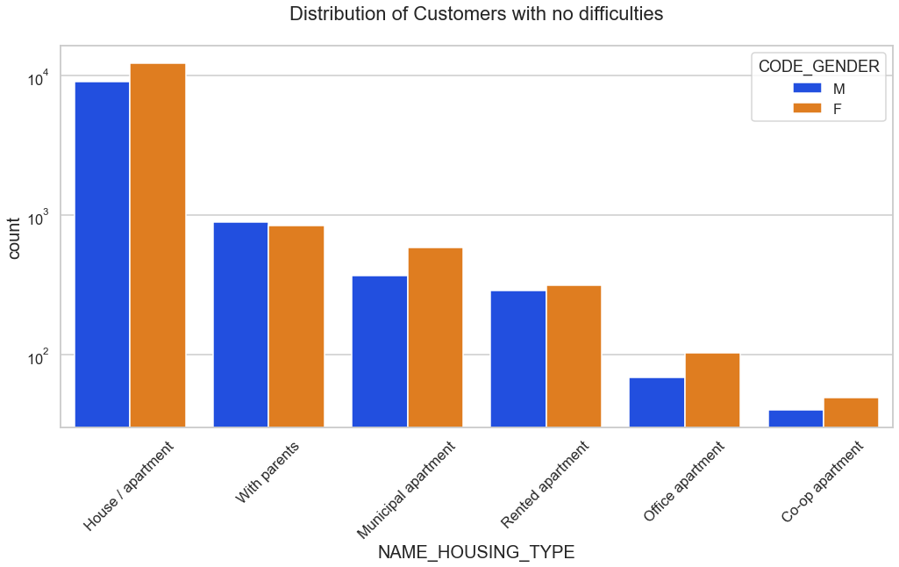
The customers who having housing type 'Rented apartment’, 'Office’ apartment' having the difficulties while paying the loan

Slide 9
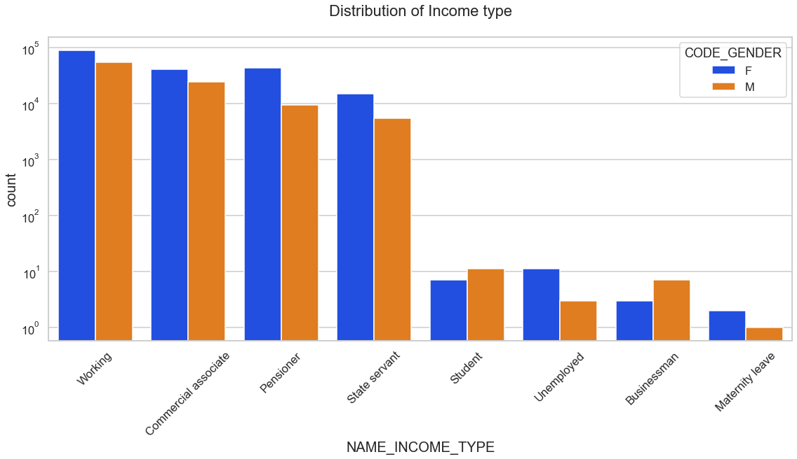
Distribution for the income type of customers who paid the credit properly

Slide 10
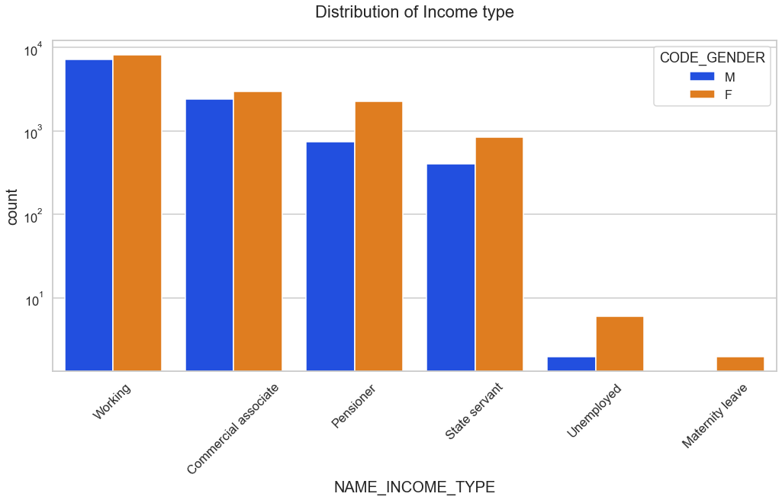
Distribution for the income type of customers who not paid the credit properly

Slide 11
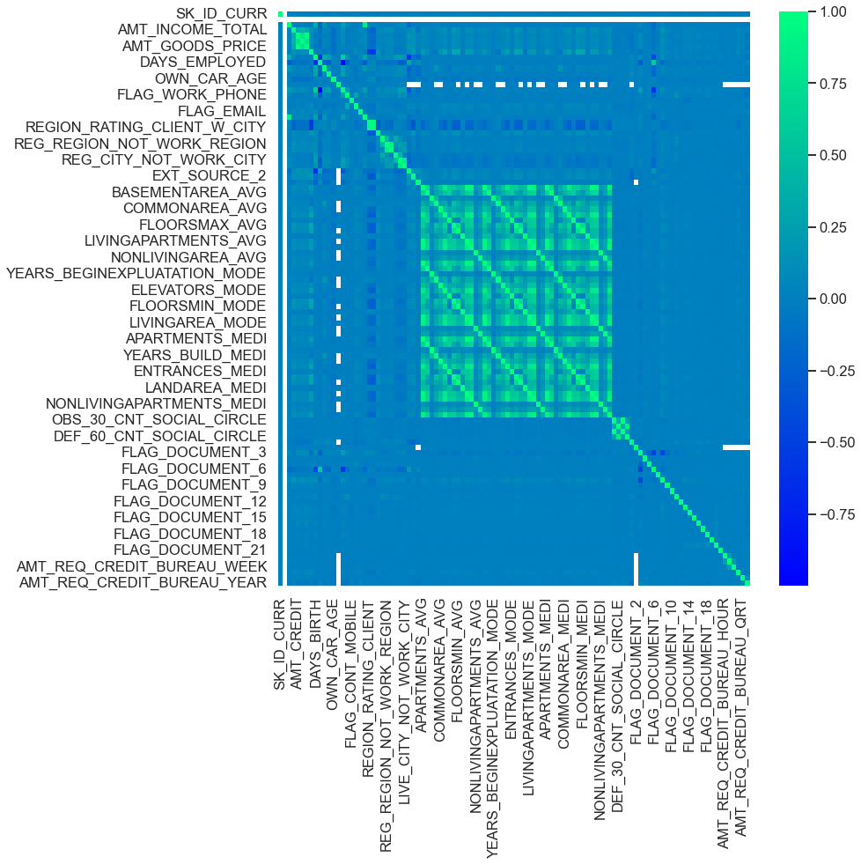
Correlation for the customers who have paid the credit on time

Slide 12
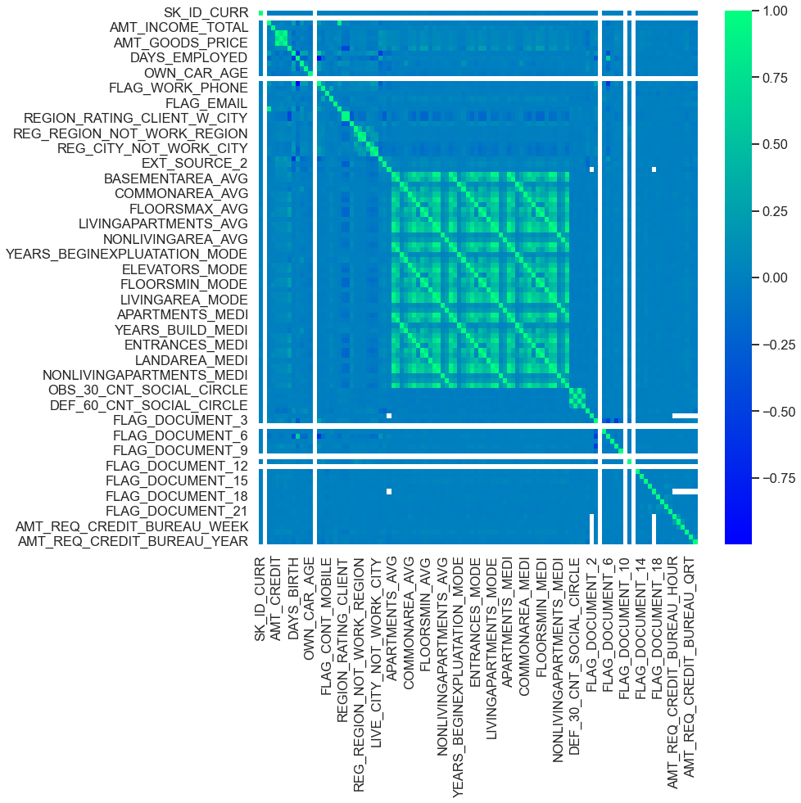
Correlation for the customers who have not paid the credit on time

Slide 13
Conclusion :
After analyzing the above dataset...
Bank should more focus on "students" and “Businessman" as they having a good credit score and history, they paying their credit on time
Bank should less focus on the "commercial associate", "Working" and "Unemployed" as they are not paying their credit on time.

Slide 14
Thank you

